Slide 1


Predicting Terrorist Behavior
Jayden Carr
Phil Ramontal
Damian Echevest
CIS543. Programming for Data Analytics

Slide 2
Data Cycle

Slide 3
Introduction
Terrorism can be defined as an attack on the rights of human’s life, property, and freedom
The problem of terrorism goes back hundreds of years. The goal of terrorist is usually to kill, strike fear and control citizens of the world

Slide 4
Problem Statement
What terrorist behaviors are common when hostages are taken
After completing Literature review the analysis gap found was of hostages taken

Slide 5
Analysis

Slide 6
Time Series Analysis

Slide 7
R PART

Slide 8
K MEANS CLUSTER

Slide 9
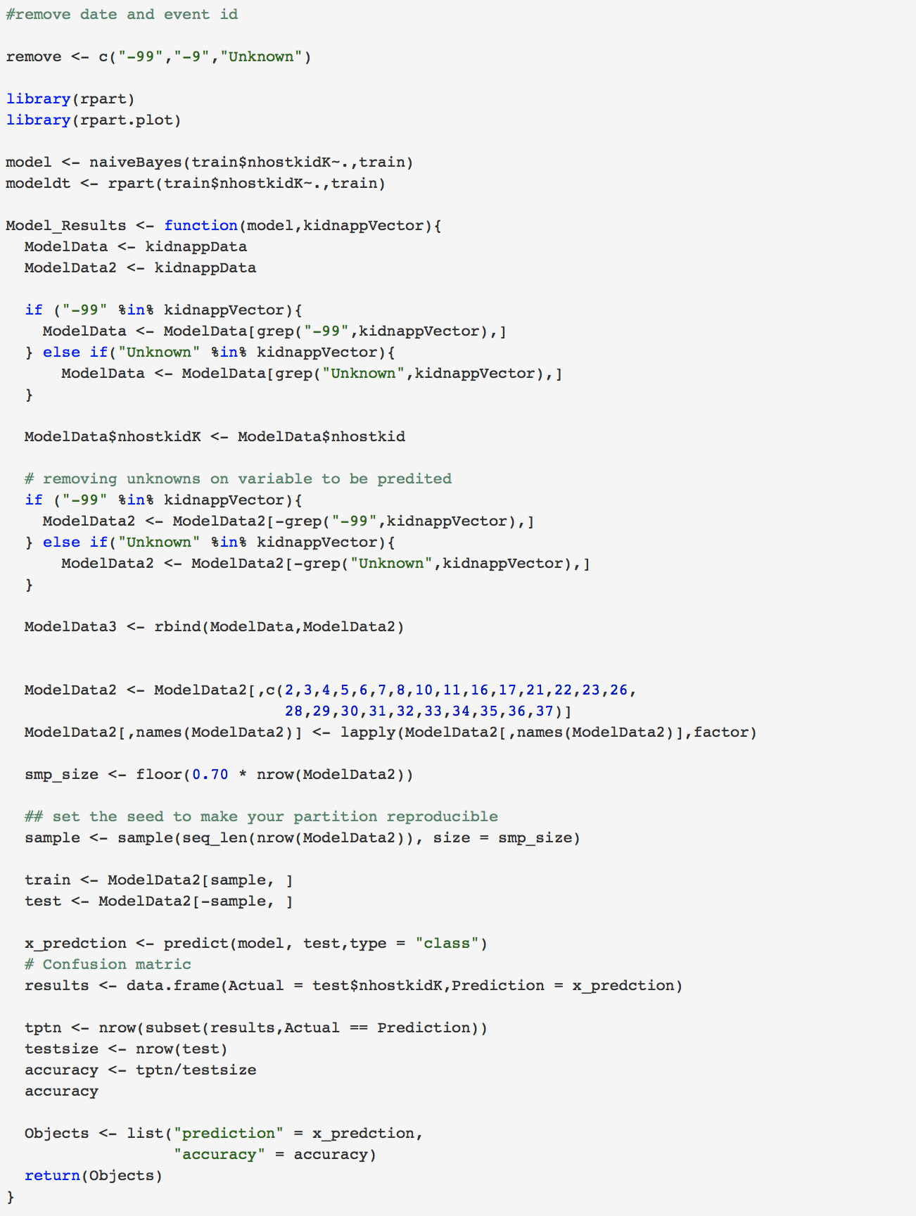
Naïve Bayes

Slide 10
Discussion

Slide 11
Q&A

